Slide 1
Imbalanced Node Classification
2024.5.30

Slide 2
Imbalanced Node Classification
2. Co-Modality Graph Contrastive Learning for Imbalanced Node Classification.
NeurIPS 2022.
3. Rethinking Semi-Supervised Imbalanced Node Classification from Bias-Variance
Decomposition.
NeurIPS 2023.

Slide 3
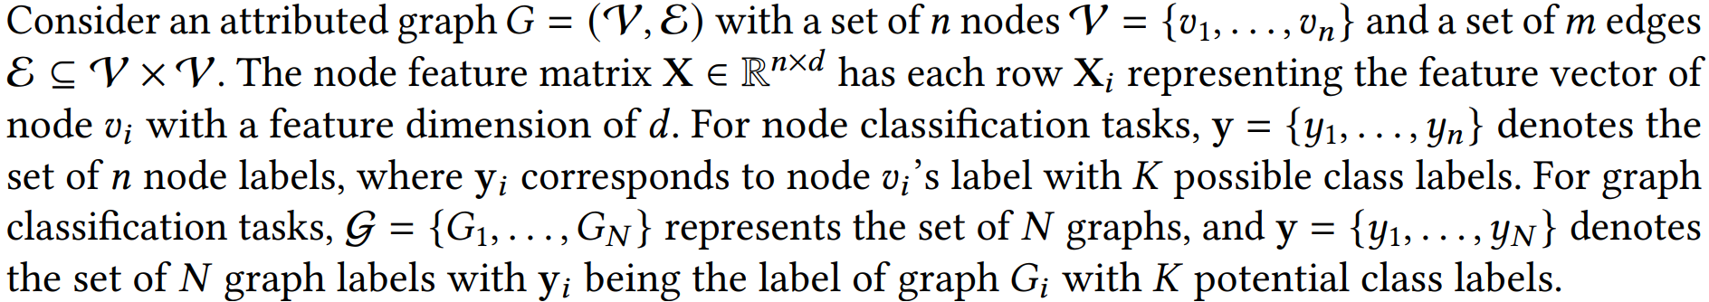
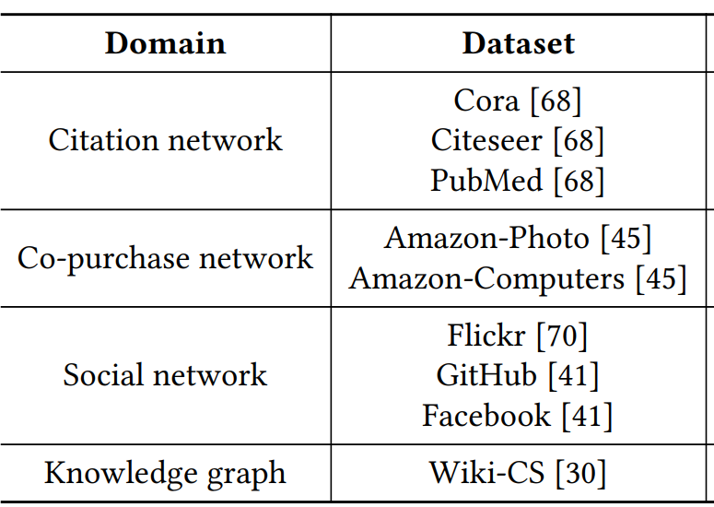
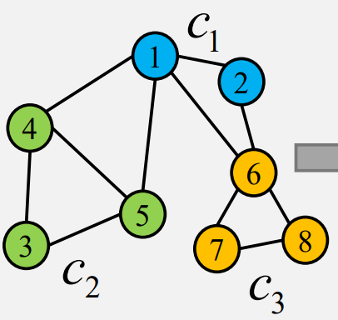
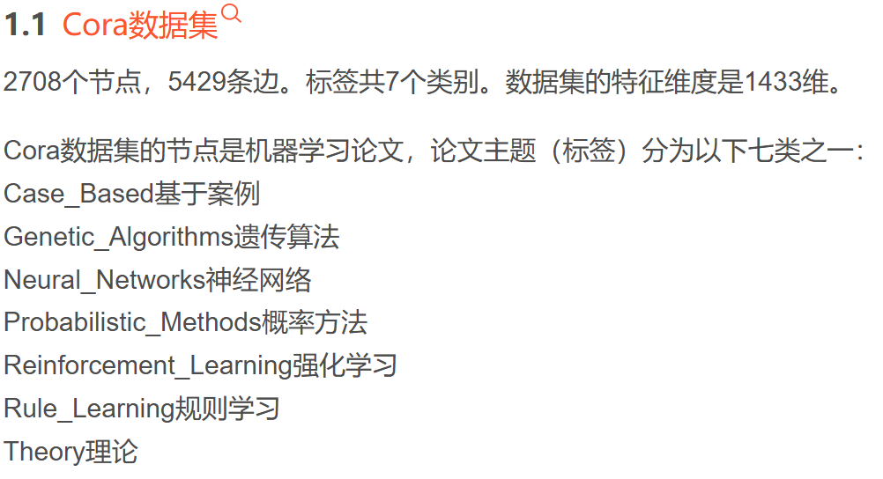

Slide 4
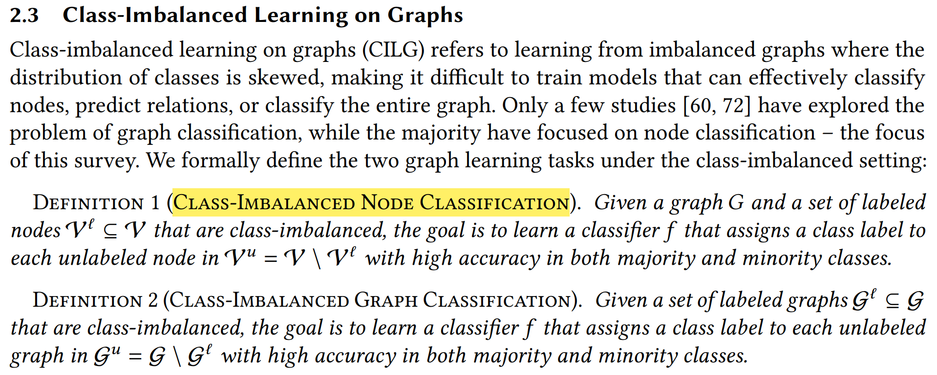

Slide 5
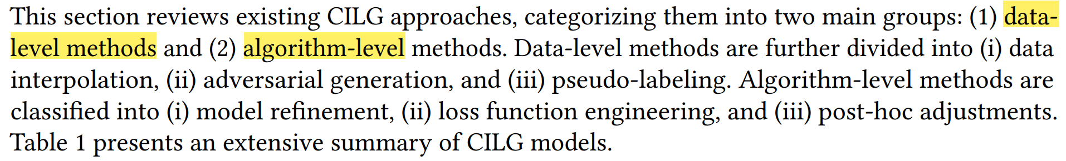
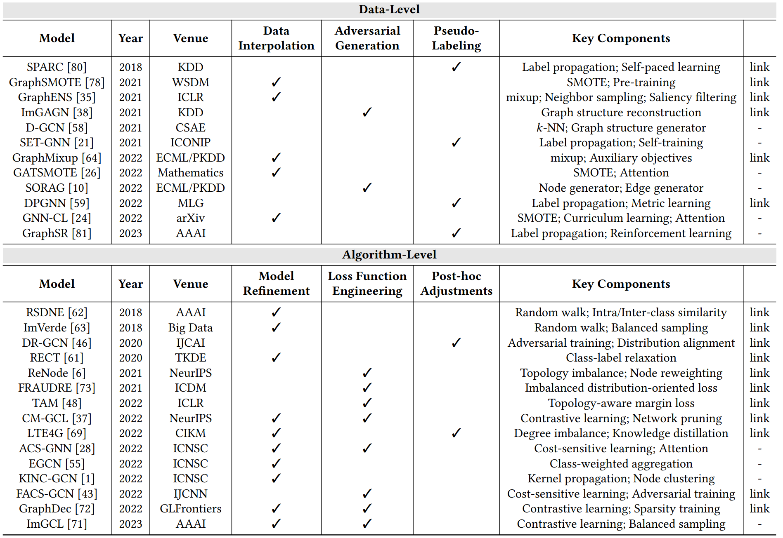

Slide 6
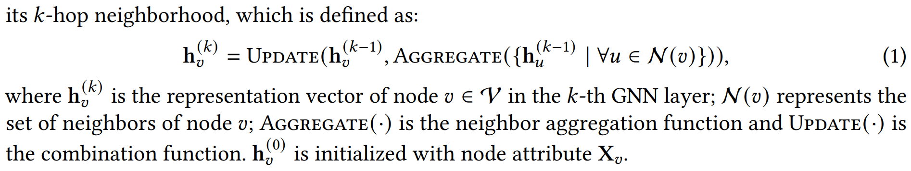
Graph neural networks (GNNs)

Slide 7
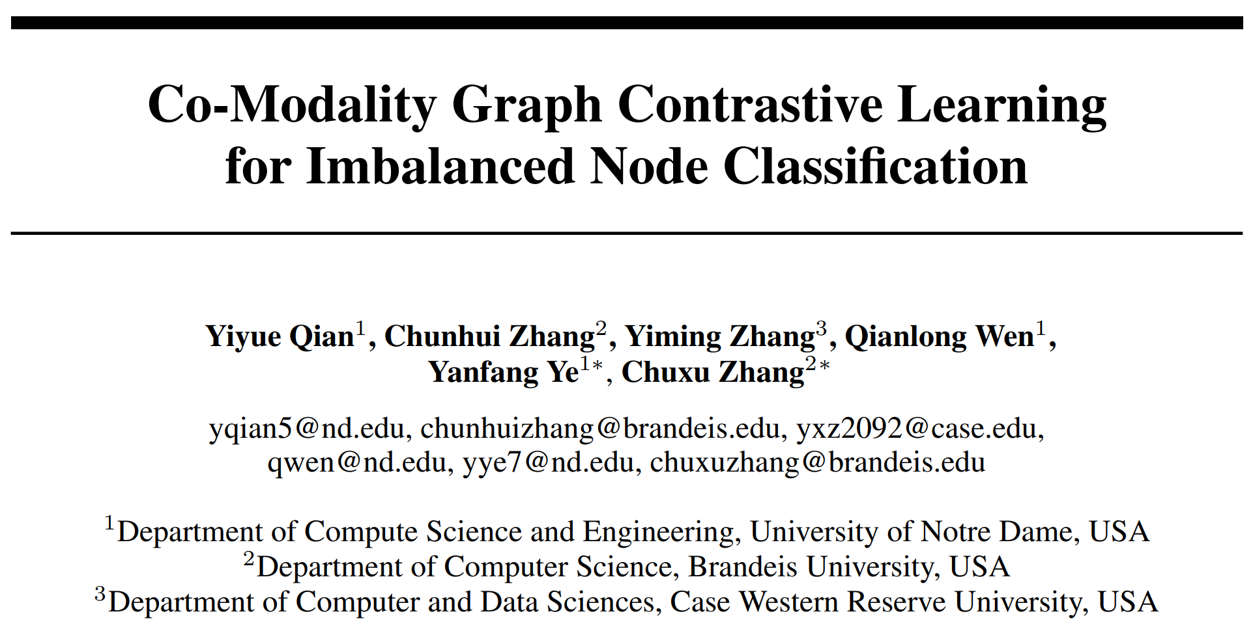
NeurIPS 2022

Slide 8
Motivation: Graph contrastive learning (GCL), leveraging graph augmentations to convert graphs into different views and further train graph neural networks (GNNs).
handcrafted graph augmentations require trials and errors, but still can not yield consistent performance on multiple tasks.
data imbalance.
Contributions:
As handcrafted graph augmentations are not efficient on real-world graph datasets, we devise a co-modality framework to automatically generate contrastive pairs. To the best of our knowledge, this is the first work on GCL that co-trains encoders in different modalities to facilitate node representation learning.
To address the class imbalance issue on graphs, our model extends network pruning to prune encoders in co-modality GCL for discovering minority samples and further learning more balanced node representations.
Extensive experiments on multiple real-world graph datasets show the effectiveness of our model by comparing CM-GCL with state-of-the-art methods.

Slide 9
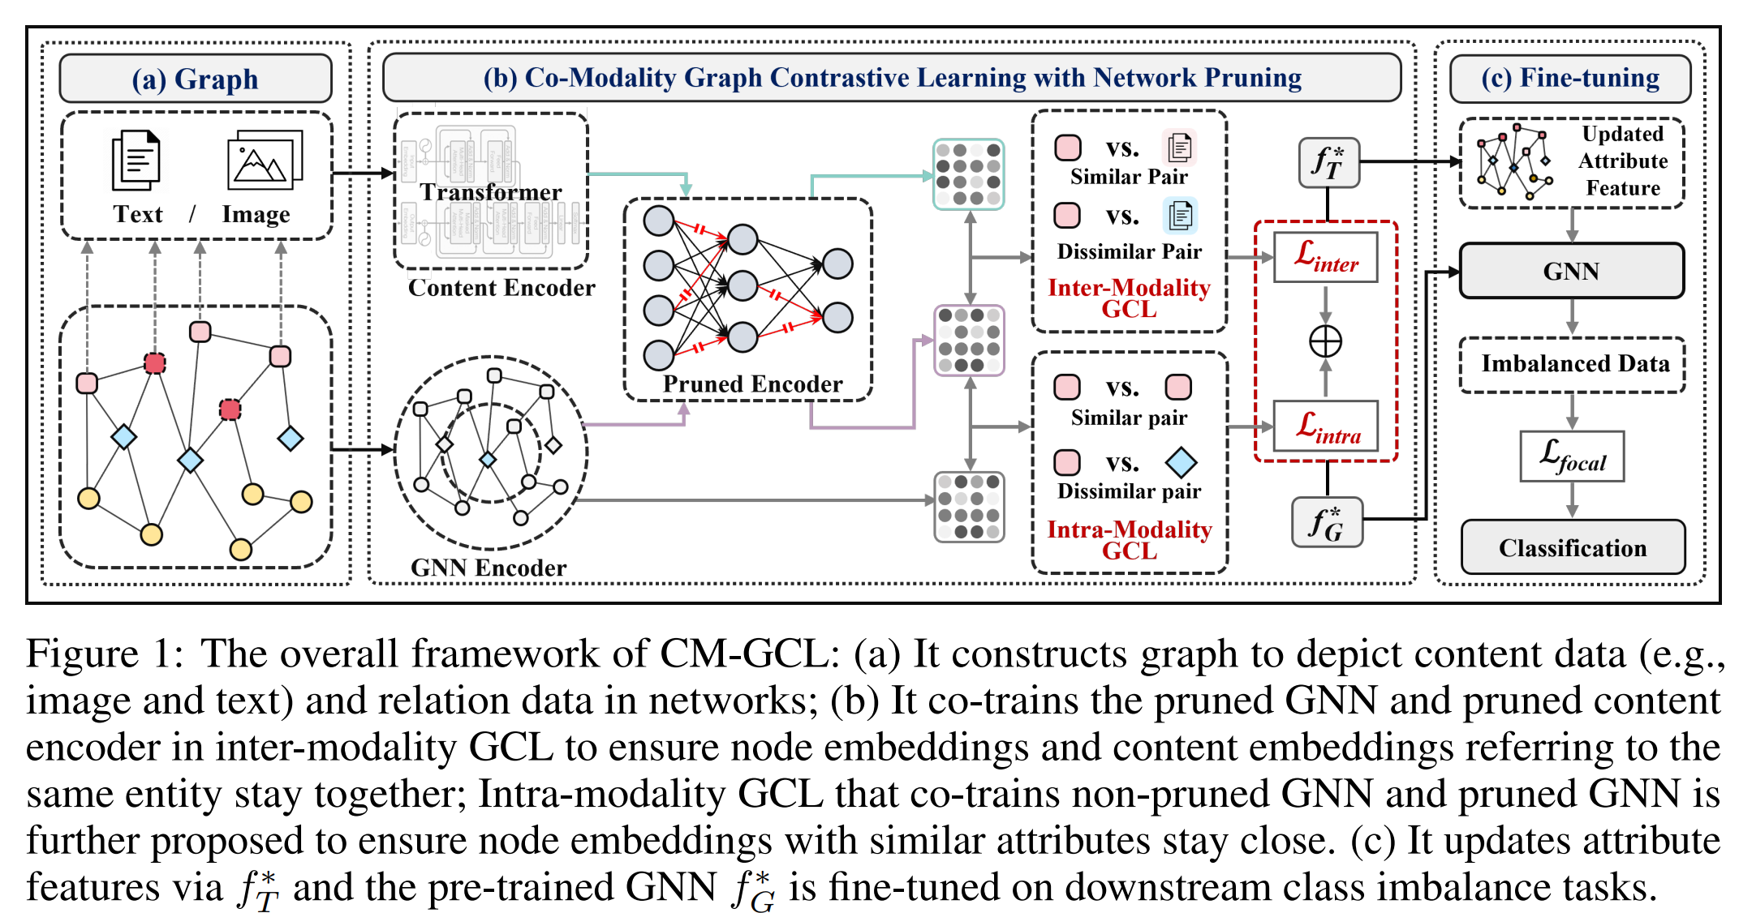

Slide 10


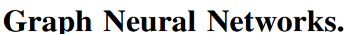
DistilBERT
ResNet50
Inter-Modality Graph Contrastive Learning
Intra-Modality Graph Contrastive Learning

Slide 11
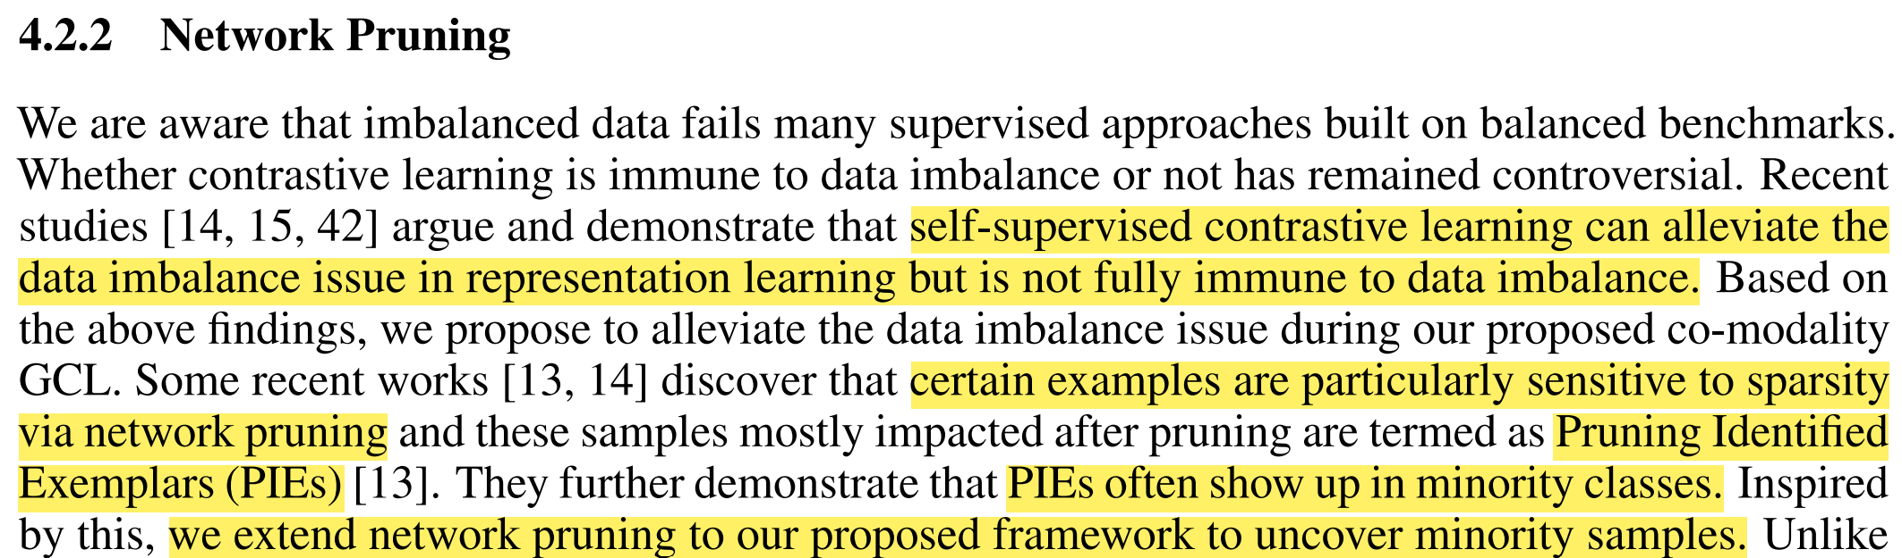
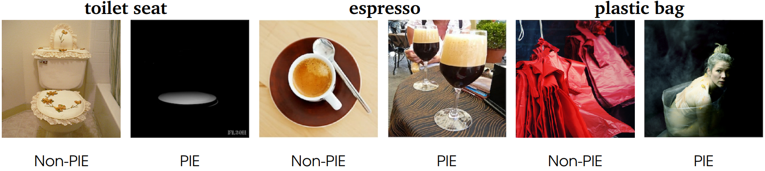
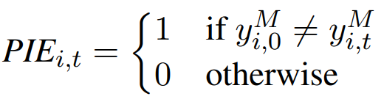
WHAT DO COMPRESSED DEEP NEURAL NETWORKS FORGET?
arXiv 2019

Slide 12
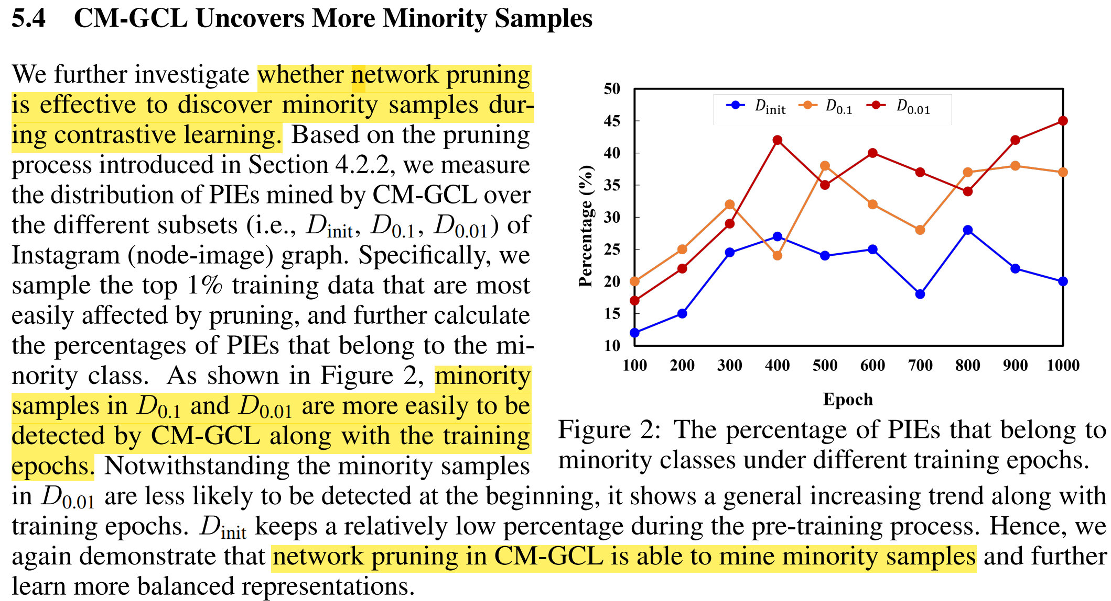

Slide 13
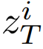
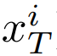
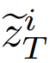
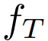
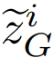
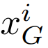
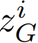
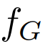
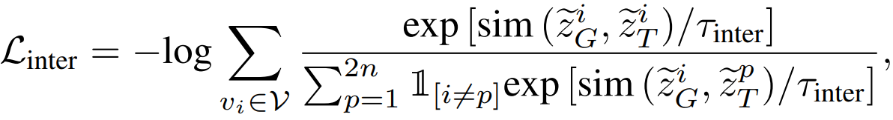

Slide 14
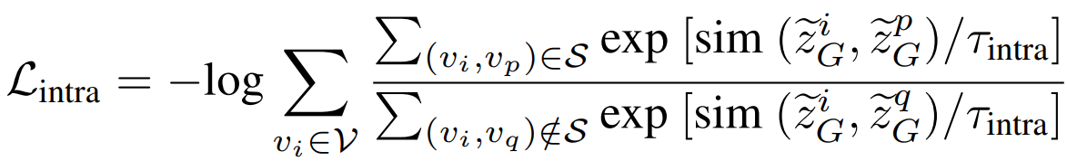
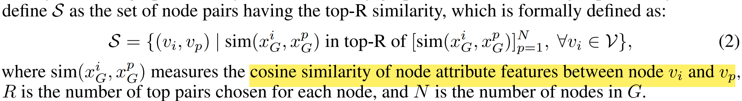

Slide 15
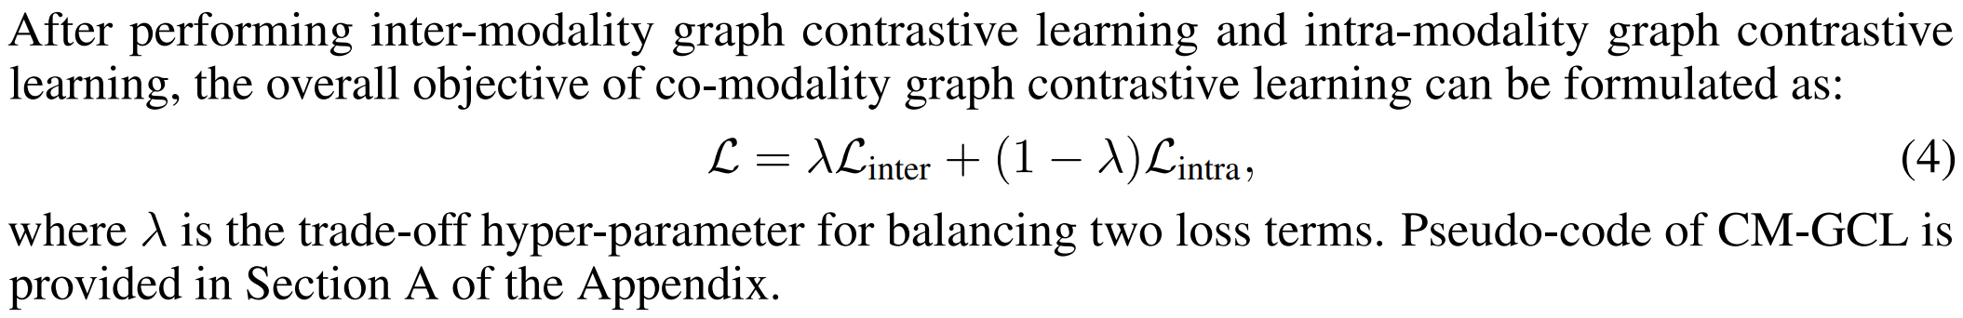

Slide 16
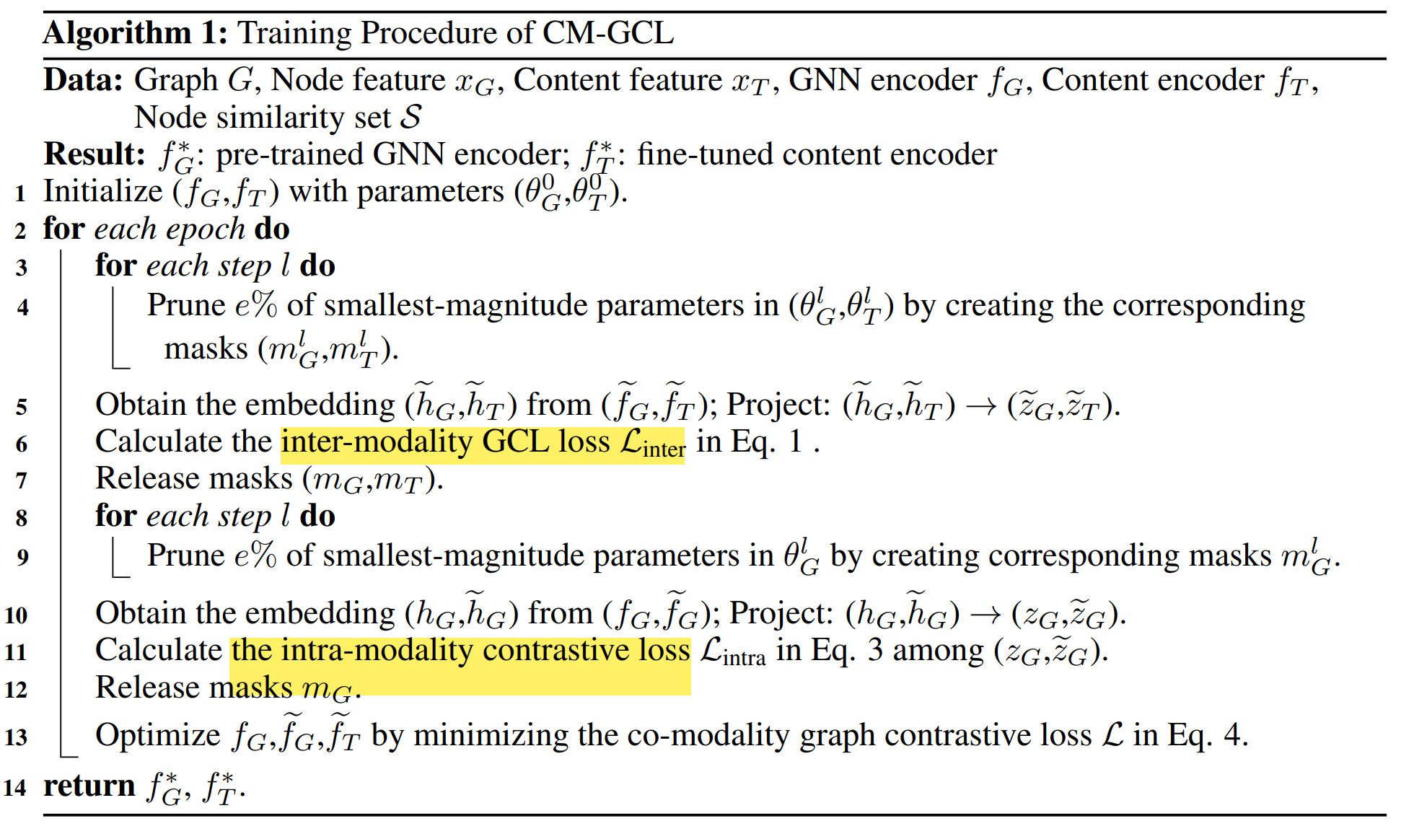

Slide 17
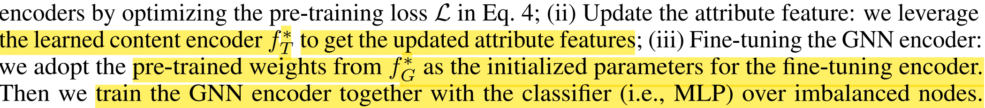
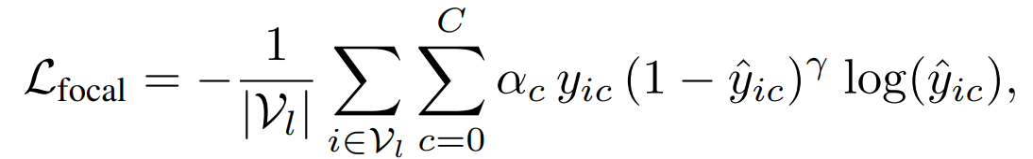
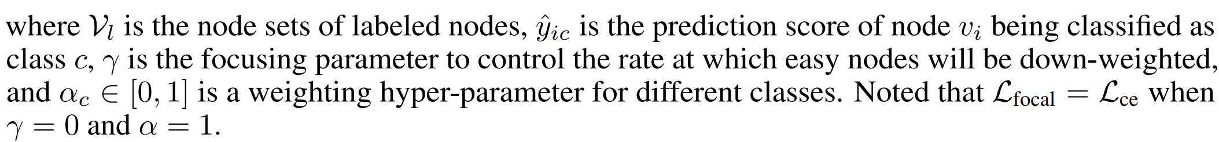

Slide 18
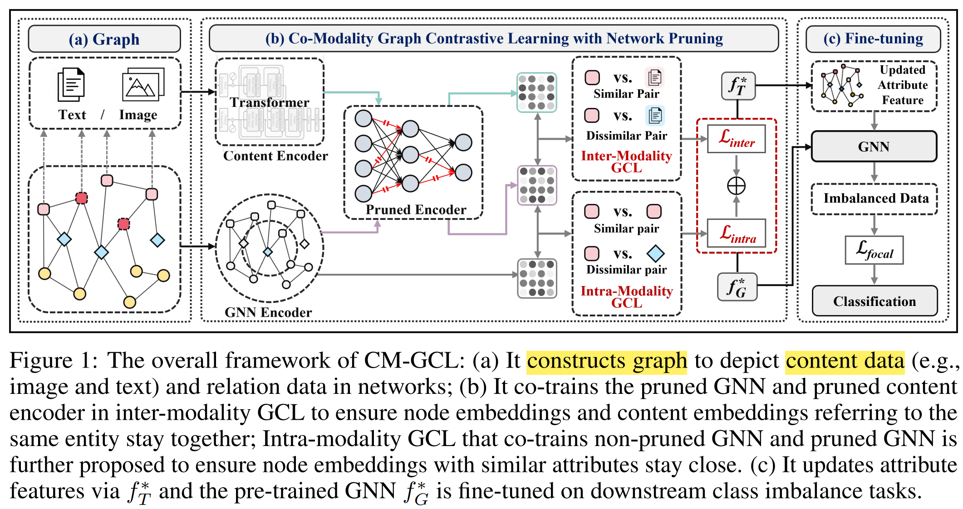

Slide 19
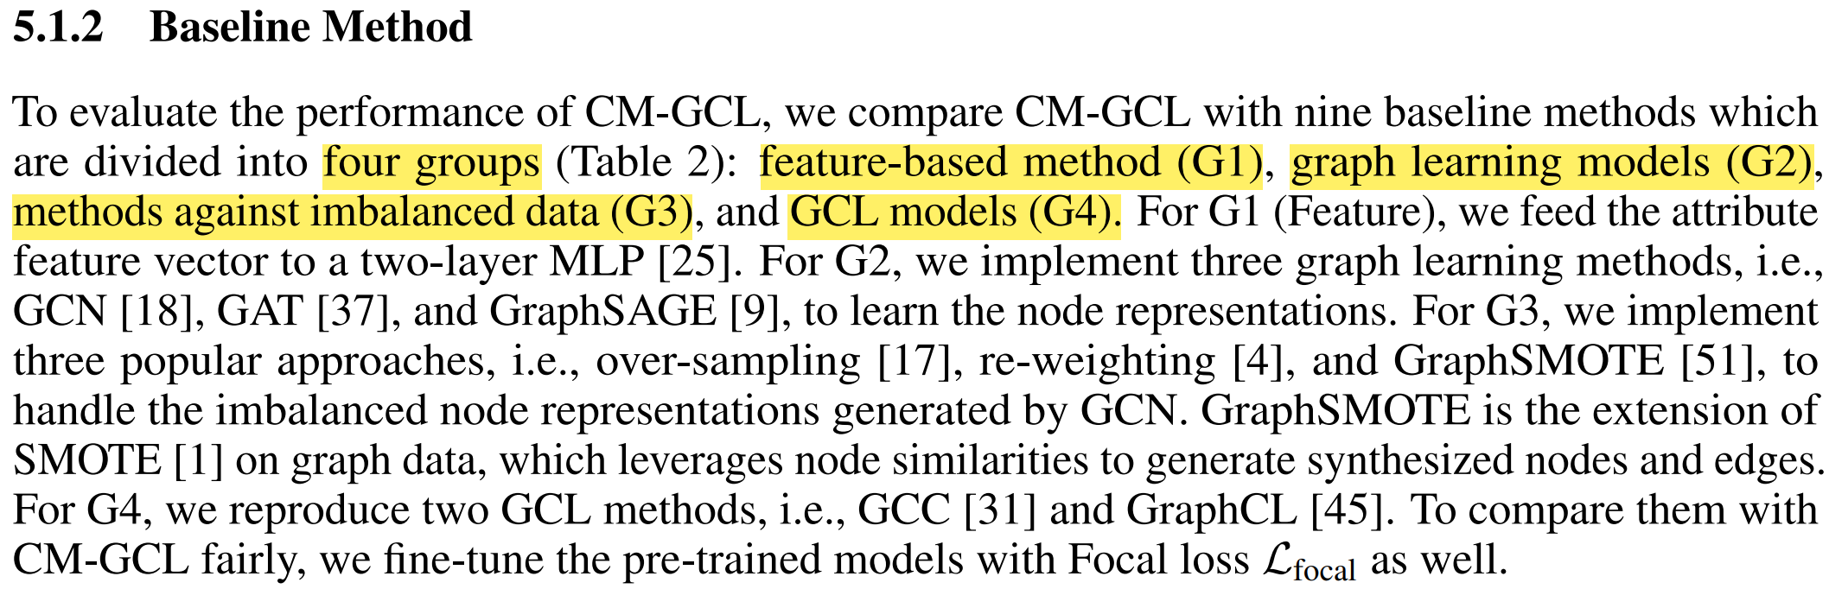

Slide 20
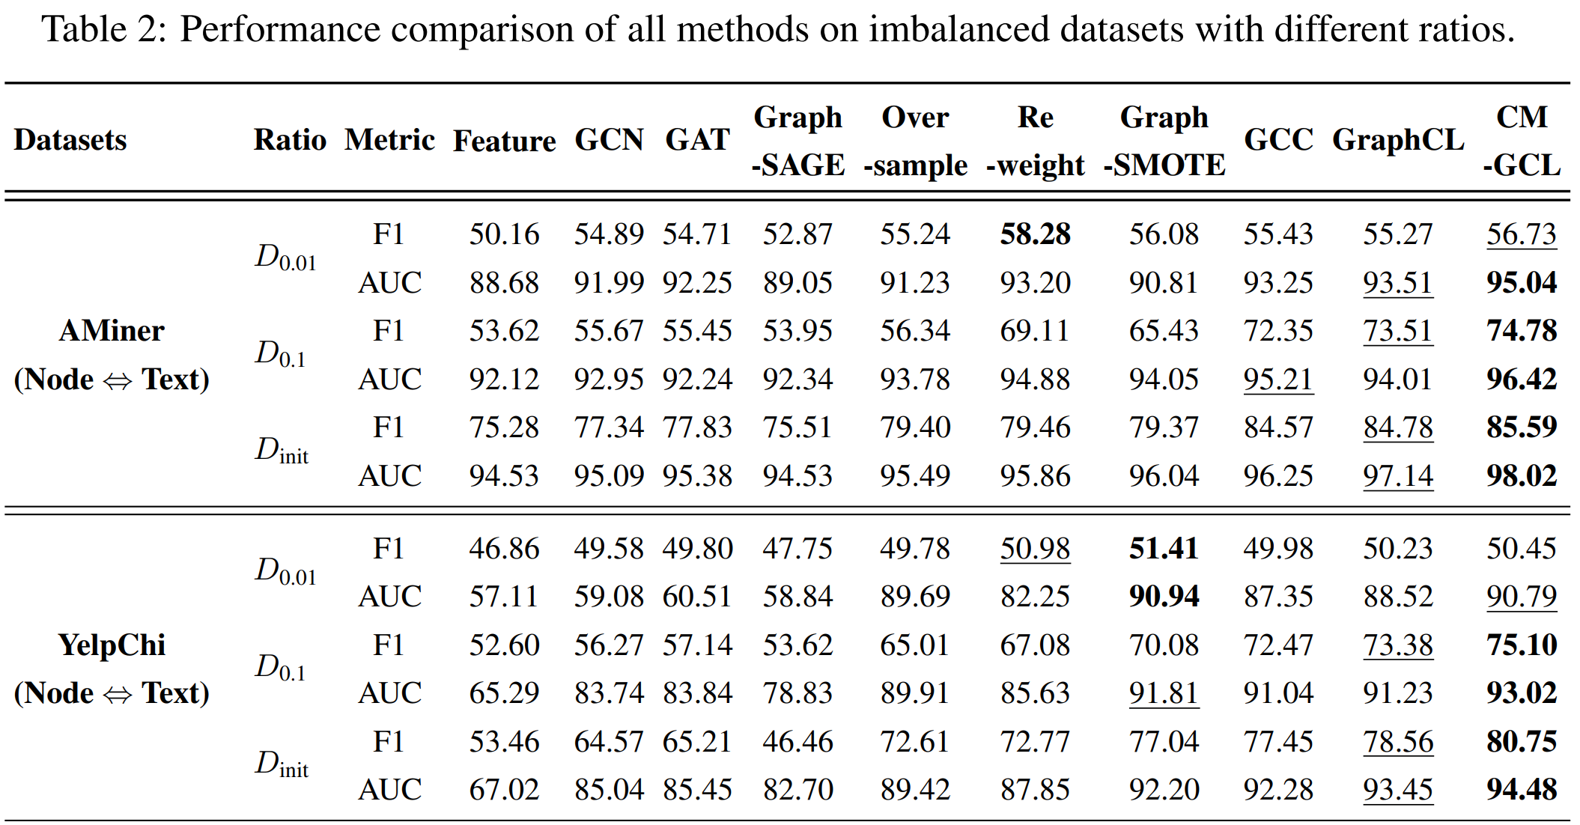

Slide 21
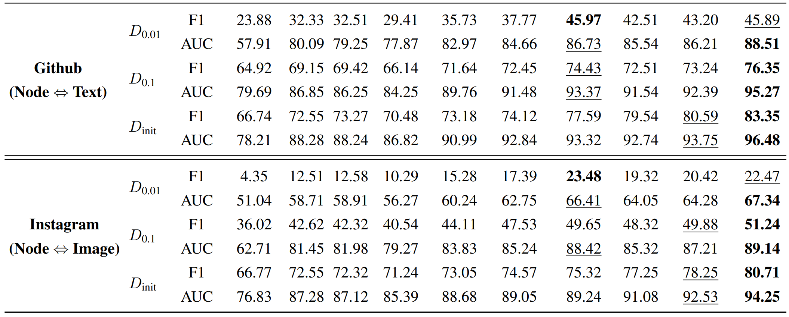

Slide 22
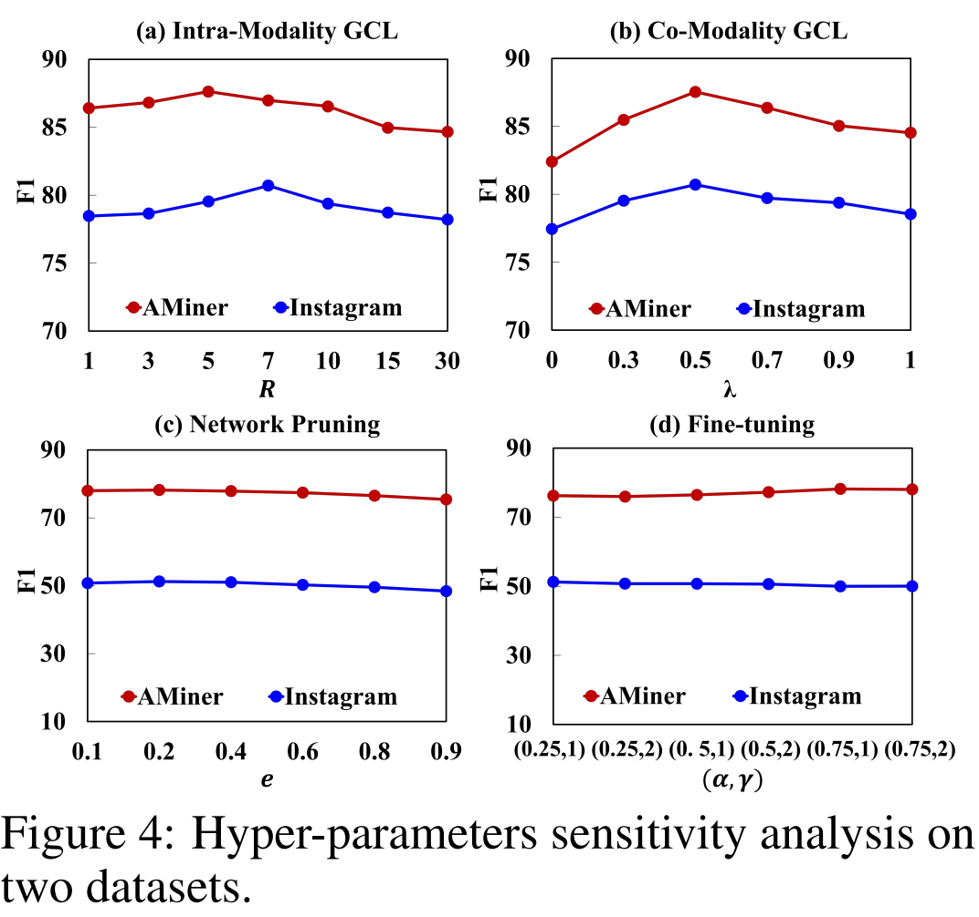
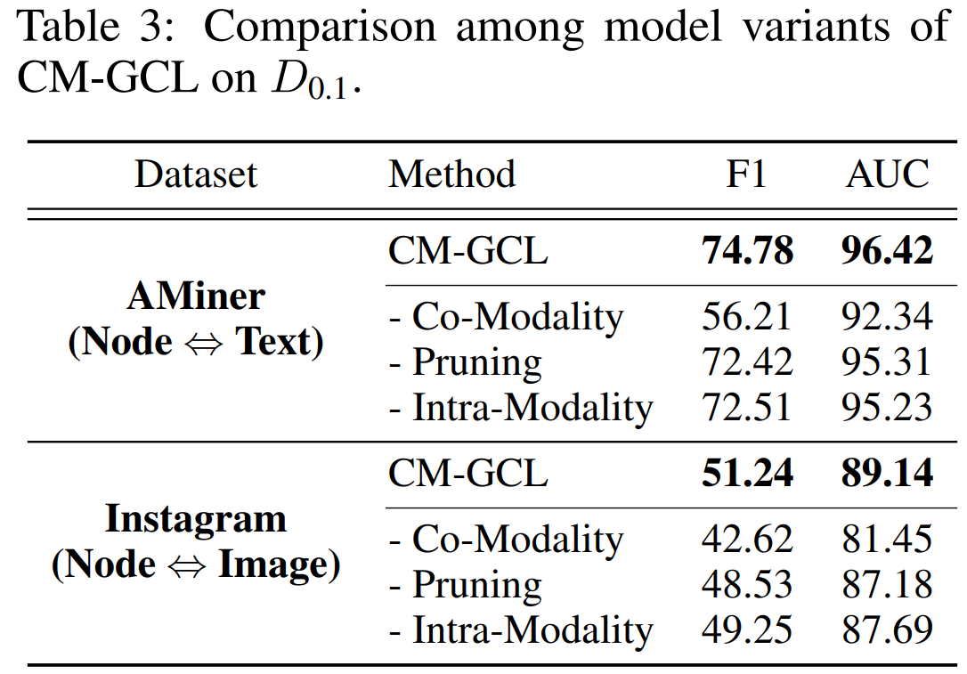

Slide 23
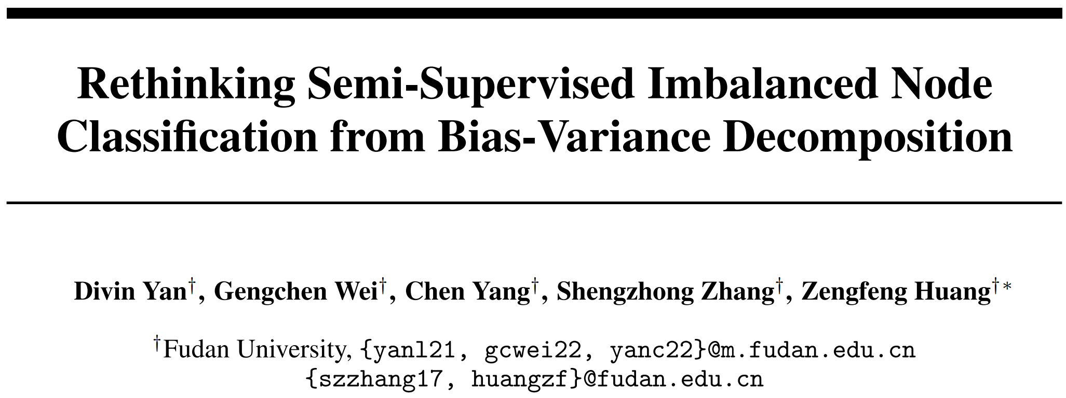
NeurIPS 2023

Slide 24
Motivation: a more fundamental and theoretical perspective is urgently needed when considering the imbalance node classification problem.
Contributions:
We are the first to integrate imbalanced node classification and Bias-Variance Decomposition. Our work establishes the close relationship between data imbalance and model variance, based on theoretical analysis. Moreover, we are the first to conduct a detailed theoretical analysis for imbalanced node classification domain.
Our principal insight is to leverage graph data augmentation as a means of representing the varied training sets that lie within the distribution, whilst simultaneously designing a regularization term that approximates the model’s variance.
We conduct exhaustive tests on multiple benchmarks, such as the naturally imbalanced datasets and the public-split class-imbalanced datasets. The numerical results demonstrate that our model consistently outperforms state-of-the-art machine learning methods and significantly outperforms them in heavily-imbalanced scenarios.

Slide 25
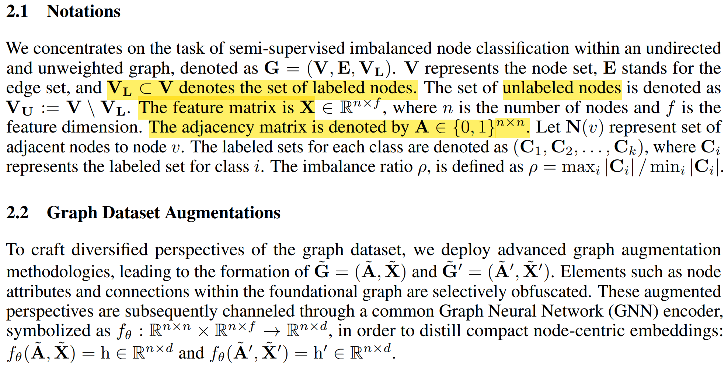

Slide 26
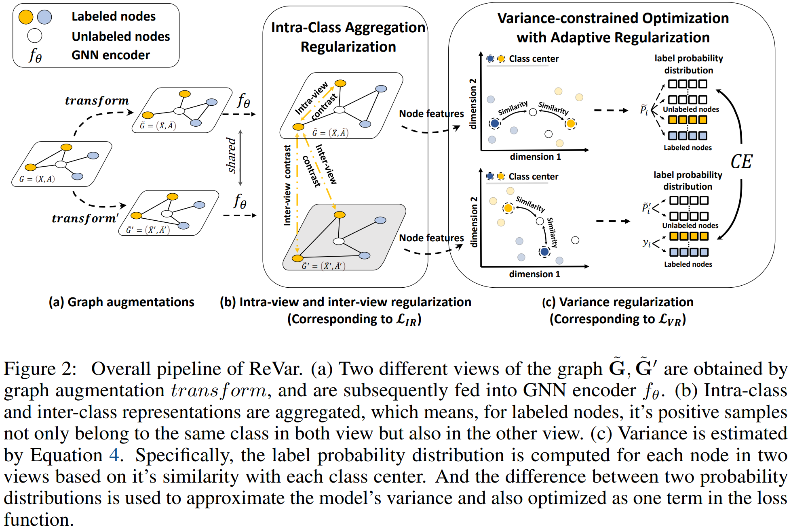

Slide 27
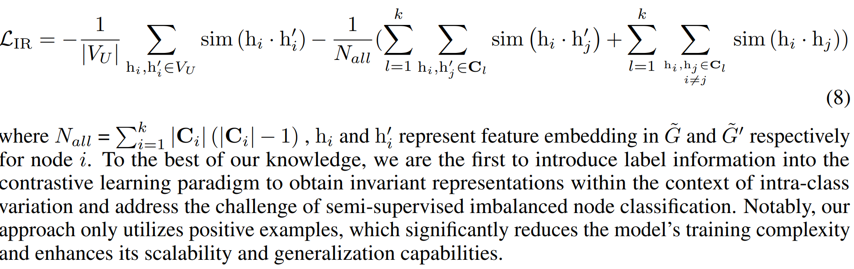

Slide 28
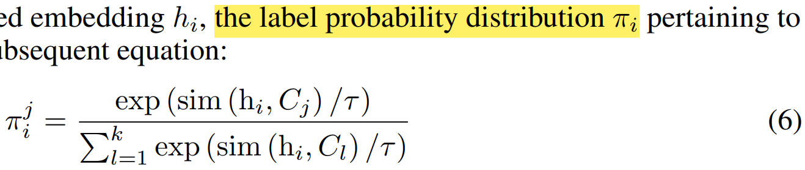
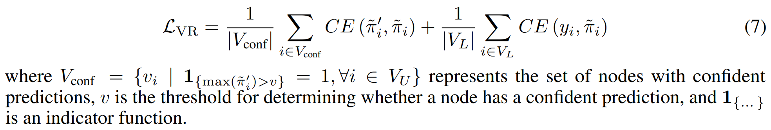

Slide 29
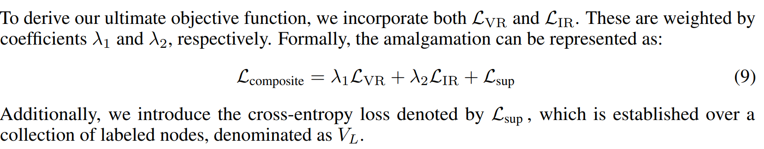

Slide 30
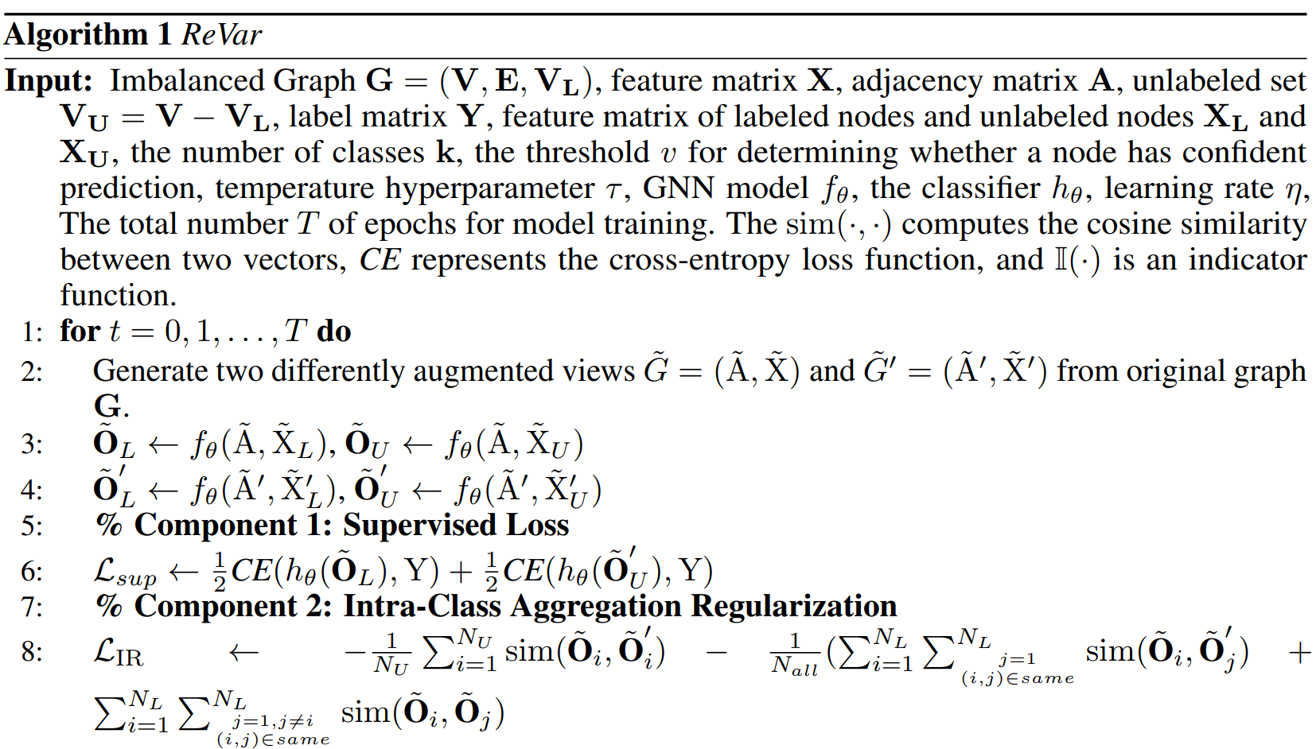

Slide 31
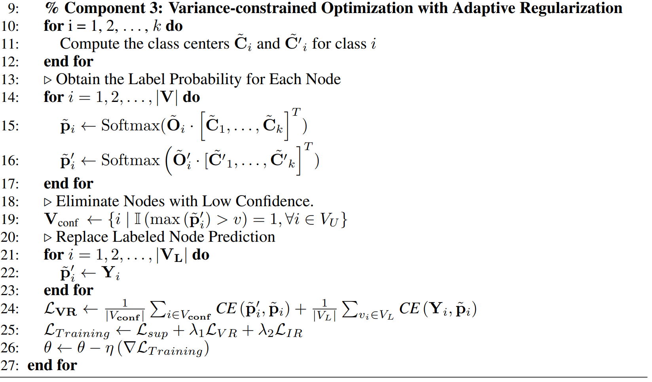

Slide 32
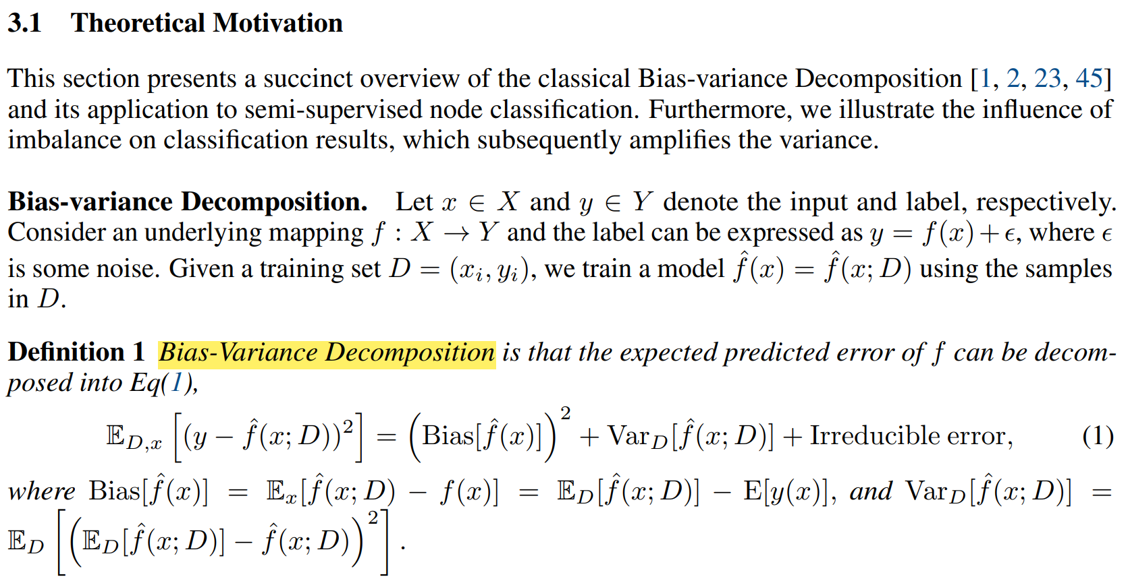

Slide 33
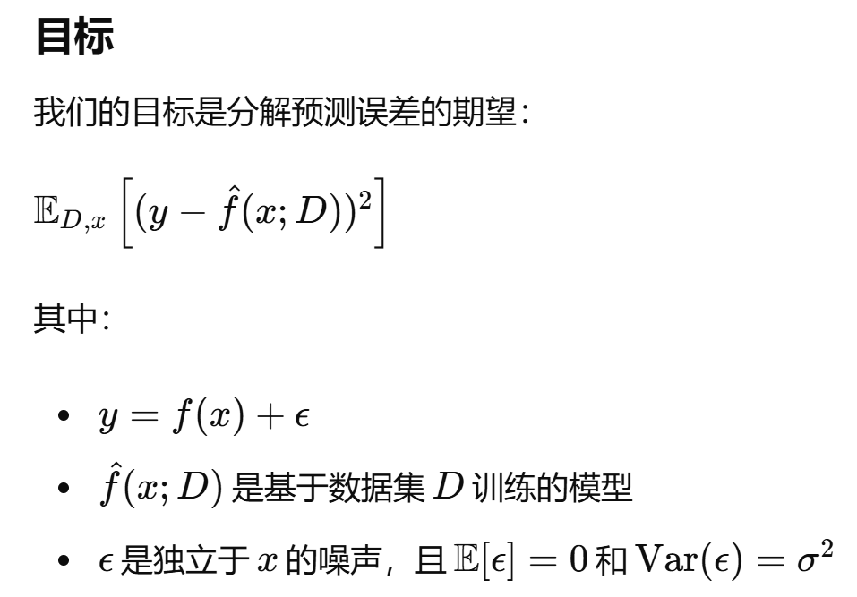
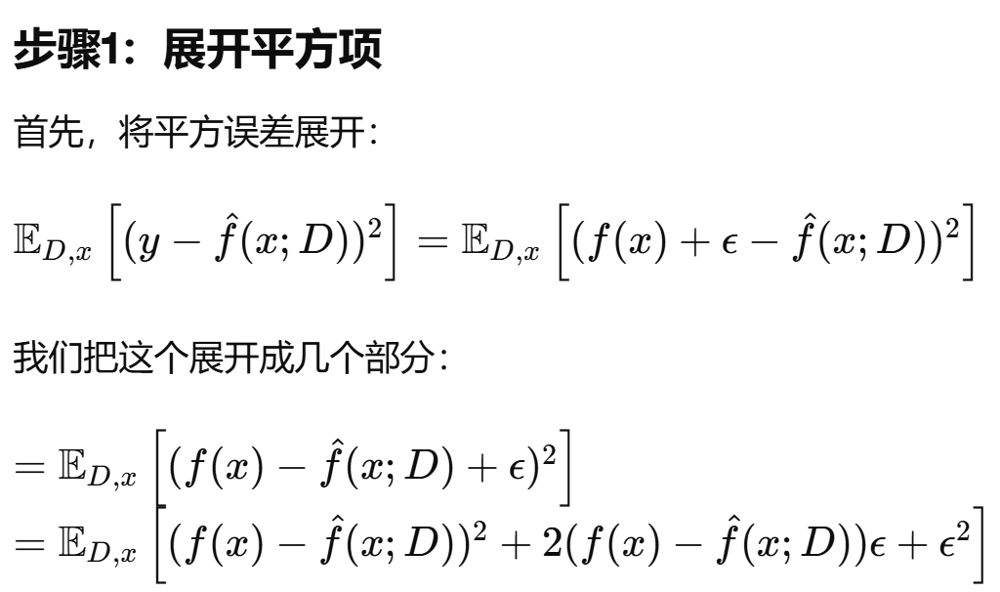
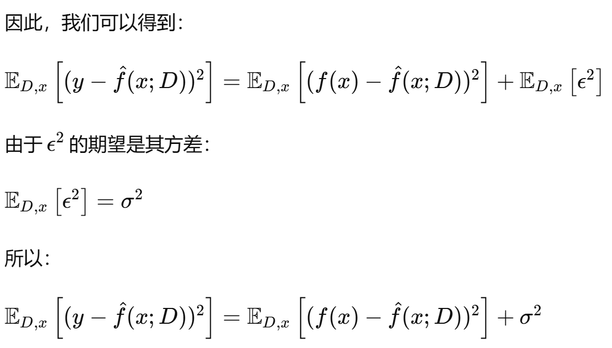


Slide 34





Slide 35


Slide 36


Slide 37



Slide 38


Slide 39


Slide 40


Slide 41
Appendix
[1] GraphSHA: Synthesizing Harder Samples for Class-Imbalanced Node Classification. KDD 2023.
[2] ImGCL: Revisiting Graph Contrastive Learning on Imbalanced Node Classification. AAAI 2023.
[3] GraphSR: A Data Augmentation Algorithm for Imbalanced Node Classification. AAAI 2023.
[4] TAM: Topology-Aware Margin Loss for Class-Imbalanced Node Classification. ICML 2022.
[5] GraphENS: Neighbor-Aware Ego Network Synthesis for Class-Imbalanced Node Classification.
ICLR 2022.
[6] GraphSMOTE: Imbalanced Node Classification on Graphs with Graph Neural Networks.
WSDM 2021.
[7] Class-Imbalanced Learning on Graphs: A Survey. ArXiv 2023.

Slide 42
THANKS

